Slide 1
The EU’s Common Agricultural Policy Conceptual Foundation: Background and Evolution
Online Workshop
July 10, 2024
Warsaw & Odesa

Slide 2
Agenda
Opening Remarks
Brief Overview of the Current State of the Project Implementation
The CAP Background and Origin
Major Reforms of the CAP
Financial Dimension of The Cap
CAP Support Evolution
Team Research Goals and Objectives
Q&A
Closing Remarks

Slide 3
Current State of the Project Implementation
Matching contribution activities including efforts to raise additional funding
Information on the Project complementary actions and developments to reinforce its research component
Participation in a panel discussion on Implications of the Potential Ukraine’s EU Membership for the Polish Agri-food Sector (May 14, 2024);
IAAE, Organized Symposium on Consequences of the Russian Invasion of Ukrainian for the World Agricultural Markets and the EU Food System: Current State and the Future Implications in the Context of Potential Accession of Ukraine to the EU; Szczepan Figiel, Zbigniew Floriańczyk (Institute of Agricultural and Food Economics – National Research Institute); Paweł Chmieliński, Barbara Wieliczko (Institute of Rural and Agricultural Development, Polish Academy of Sciences); Taras Gagalyuk (Leibniz Institute of Agricultural Development in Transition Economies (IAMO), Germany); and Hrabrin Bachev (Institute of Agricultural Economics-Sofia, Bulgaria); 32 ICAE, New Delhi August 7, 2024
Paper proposal entitled Harvesting Synergy: Alignment of Ukrainian and the EU's Agricultural Policies prepared for 189th Seminar of the European Association of Agricultural Economists (EAAE)on EU enlargement by (post-)war Ukraine: Implications for the Agri-Food Markets, Warsaw University of Life Sciences - SGGW, Poland, September 18-20, 2024

Slide 4
The CAP Background and Origin
Initiated after World War II as part of the Treaty of Rome signed in 1958.
General purpose:
post-war shortages and intention to explore ways to become self-sufficient in food and agricultural production at the regional level
establishing guaranteed markets as well as a fair price for agricultural producers
The CAP went into effect in 1963 with four basic principles:
A unified market for the free movement of agricultural products in the European Union covered by community preference
Financial solidarity
Community preference
Parity and productivity

Slide 5
Major Reforms of the CAP
The 1992 Mac Sharry reform: the great turning point
Agenda 2000: a new stage to build on the 1992 reform
The June 2003 reform: towards a CAP based on decoupled aid
The 2009 ‘Health Check’: consolidation of the 2003 reform framework.
The 2013 reform: a more global and integrated approach
The post-2020 reform: ‘green orientation’ and strong emphasis on results and performance

Slide 6
Changes in the Level and Share (%) of Expenditures on Agriculture in the Total EU Budget in 1961-2016
Item | 1961-65 | 2016
Level (bill. euros) | 0.0034 | 57.41
Share (%) | 1.7% | 42.1%

Slide 7
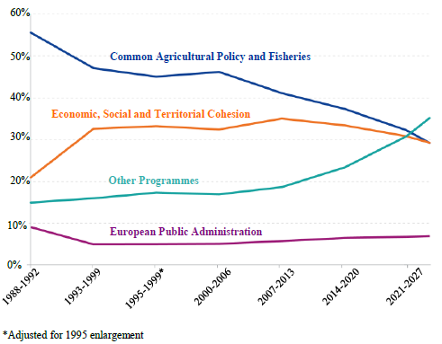
Evolution of Main Policy Areas in the EU Long Term Budgets
2007 – agriculture was included in a broader category called "PRESERVATION AND MANAGEMENT OF NATURAL RESOURCES"
2014 – agriculture was included in a broader category called "SUSTAINABLE GROWTH: NATURAL RESOURCES"

Slide 8
CAP support evolution: from agriculture products to public goods (I)
(1957-1968) To meet food needs in post-war Europe: agricultural subsidies, guaranteed prices, support of agrarian transformation
(1968-1975) Imbalance between the supply of agricultural commodities and demand, an increase in budget spending, deepening of the disparity of income, frozen agrarian structure: price-income support instruments
(1980s – 1992) Modernisation of farms and increase of scale of production: assistance in land reclamation programs, support for professional education, support for liquidation of the farm in unfavourable for agriculture production areas.

Slide 9
CAP support evolution: from agriculture products to public goods (II)
(1993-2000) Multifunctionality of agriculture, preservation of the natural environment, rural landscape and strengthening the agricultural model based on the dominance of strong family farms: elimination of export subsidies and redirection of the direct payments to support public goods
(2001-2007) Increasing competitiveness in the domestic and foreign markets, food safety and quality, stabilizing agricultural income, integrating the goals of conservation environment, and the creation of alternative (non-agricultural) sources of income and employment: support integrated with pro-environment practices and for rural development, further decoupling of direct payments
(2007 – ) Acceleration of structural transformation, further greening of agriculture and higher flexibility in policy implementation: support to green methods of production and possibility to support specific sectors of production

Slide 10
Critics that drives CAP development
Hinders the growth modernisation of agriculture in developing countries. Coupled payments and export subsidies were among the policies criticised (Matthews, 2011).
Artificially inflates food prices. In the presence of international trade, higher farm prices in the EU are only possible if the volume of lower priced imports is restricted.
Promotes a diet that is unhealthy.
Provides too much support to larger farms at the expense of providing additional support to smaller farms.
Exacerbates a range of environmental concerns relating to agriculture.
Hinders a more equitable distribution of the EU budget. This is because a large share of the overall EU budget is spent on agriculture, while the size of the agricultural sector within the economies of the MS’ is not uniform.
Does not well reflect the UN SDGs.
Source: MEF4CAP_Deliverable D1.1 Evolution CAP

Slide 11
Q & A
Next steps
Survey on the most interesting topics to be addressed

